Slide 1

Inferring Group Identities through Social Media
Asaf Beasley¹, Winter Mason²
¹Indiana University
²Stevens Institute of Technology

Slide 2
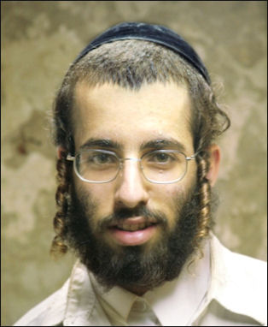
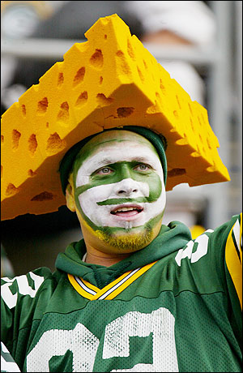
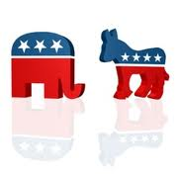
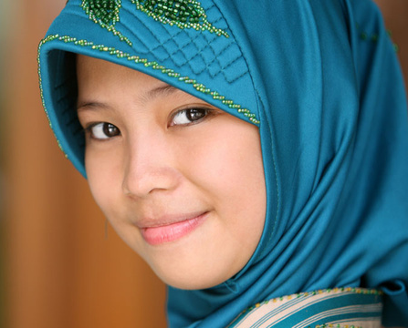
Group Identity
“those aspects of a persons self-concept based upon their group memberships together with their emotional, evaluative and other psychological correlates”
-Turner & Oakes 1986

Slide 3

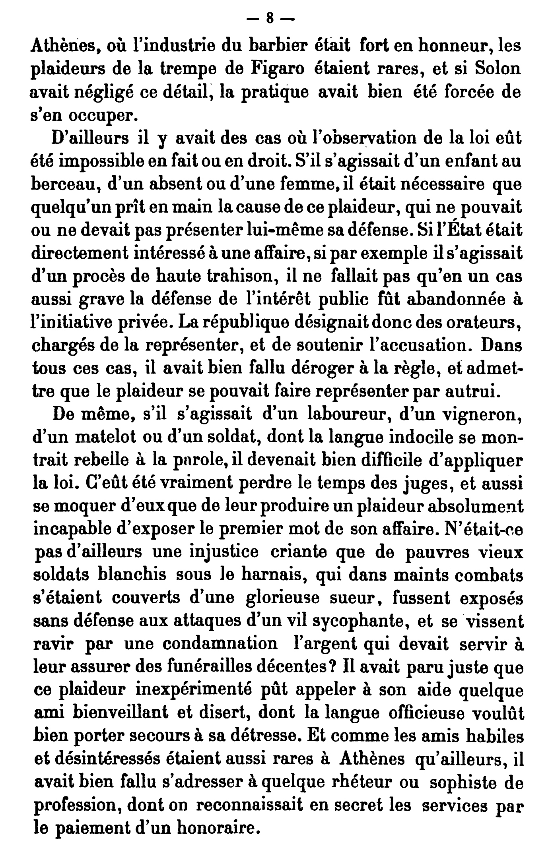




“Latent attribute inference"

Slide 4
Rao, Yarowsky, Shreevats, & Gupta (2010)
Used ensemble (stacked) SVMs with textual features for classification
Users drawn from group-relevant Twitter lists
E.g., sororities vs. fraternities for gender
Or from group-relevant hashtags
E.g., #ProudDemocrat vs. #SupportPalin
Ground truth classification uncertain, (intentionally) biased sample

Slide 5
Pennacchiotti & Popescu (2011)
Uses Gradient Boosted Decision Trees (GBDT) with textual & graph-based features for classification
Users are drawn from “WeFollow” and “Twellow”, sites that allows users to self-nominate their Twitter accounts to be affiliated with a group
Again, (intentionally) biased sample
Classification results for political affiliation
Classification results for Starbucks affiliation

Slide 6
Zamal & Ruths (2012)
Tried both Gradient Boosted Decision Trees (GBDT) and SVMs, found SVMs performed best
Used primarily textual features, with some ego-network features
Gender was found by finding user names that matched top 100 most common male & female names in US Social Security dB
Users for political classification were drawn from “WeFollow” and “Twellow”, sites that allows users to self-nominate their Twitter accounts to be affiliated with a group
Again, (intentionally) biased sample
Classification accuracy with different models

Slide 7
How well can you infer group identity in typical users?
(from their social media presence)

Slide 8
Survey

Slide 9
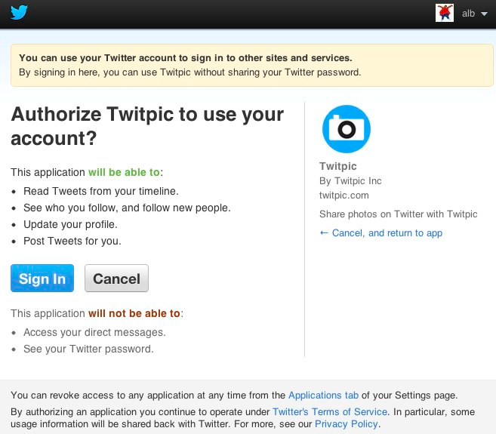

Slide 10
Survey Questions
National Identity & (for U.S. participants) Political Identity:
14 question, 5 factor measure of in-group identification (Leach et al 2008):
Solidarity
“I feel a bond with [in-group]”
Satisfaction
“I am glad to be [in-group]”
Centrality
“I often think of the fact that I am [in group]”
Individual Self-Stereotyping
“I am similar to the average…”
In-Group Homogeneity
“[In-group] people have a lot in common with each other”
Up to 3 additional identities with whom the participant strongly identifies

Slide 11

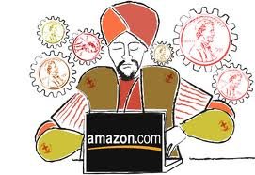
Our Participants
1392 Survey Respondents
~ 400 from Mechanical Turk
~ 1000 from Indiana University subject pool

Slide 12
…
Median age: 20
40 unique countries

Slide 13
Only U.S. participants were asked about their political identity

Slide 14
Twitter Data
Twitter crawling limits
-Up to 3200 tweets per person
-Up to 1000 Tweets from each of the individuals they follow
Approximately 82,000,000 Tweets total
Approximately 500,000 tweets from our participants

Slide 15
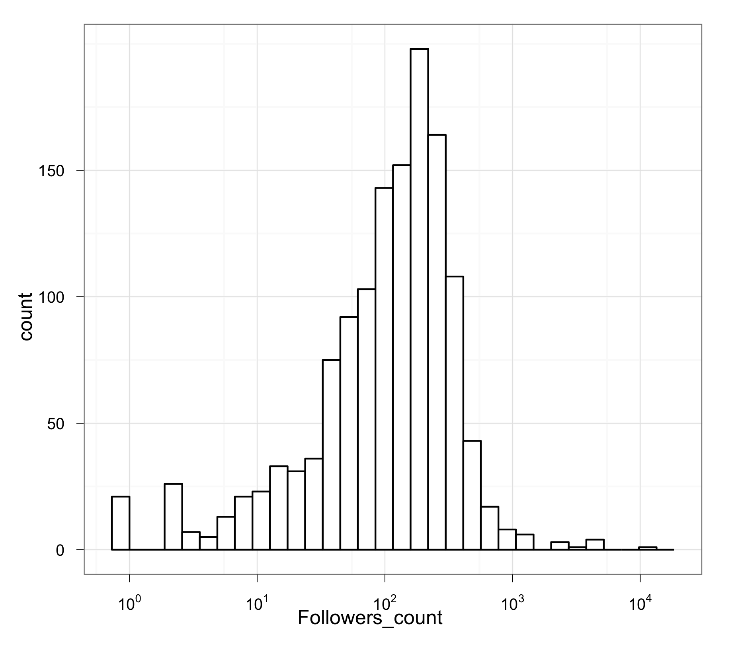
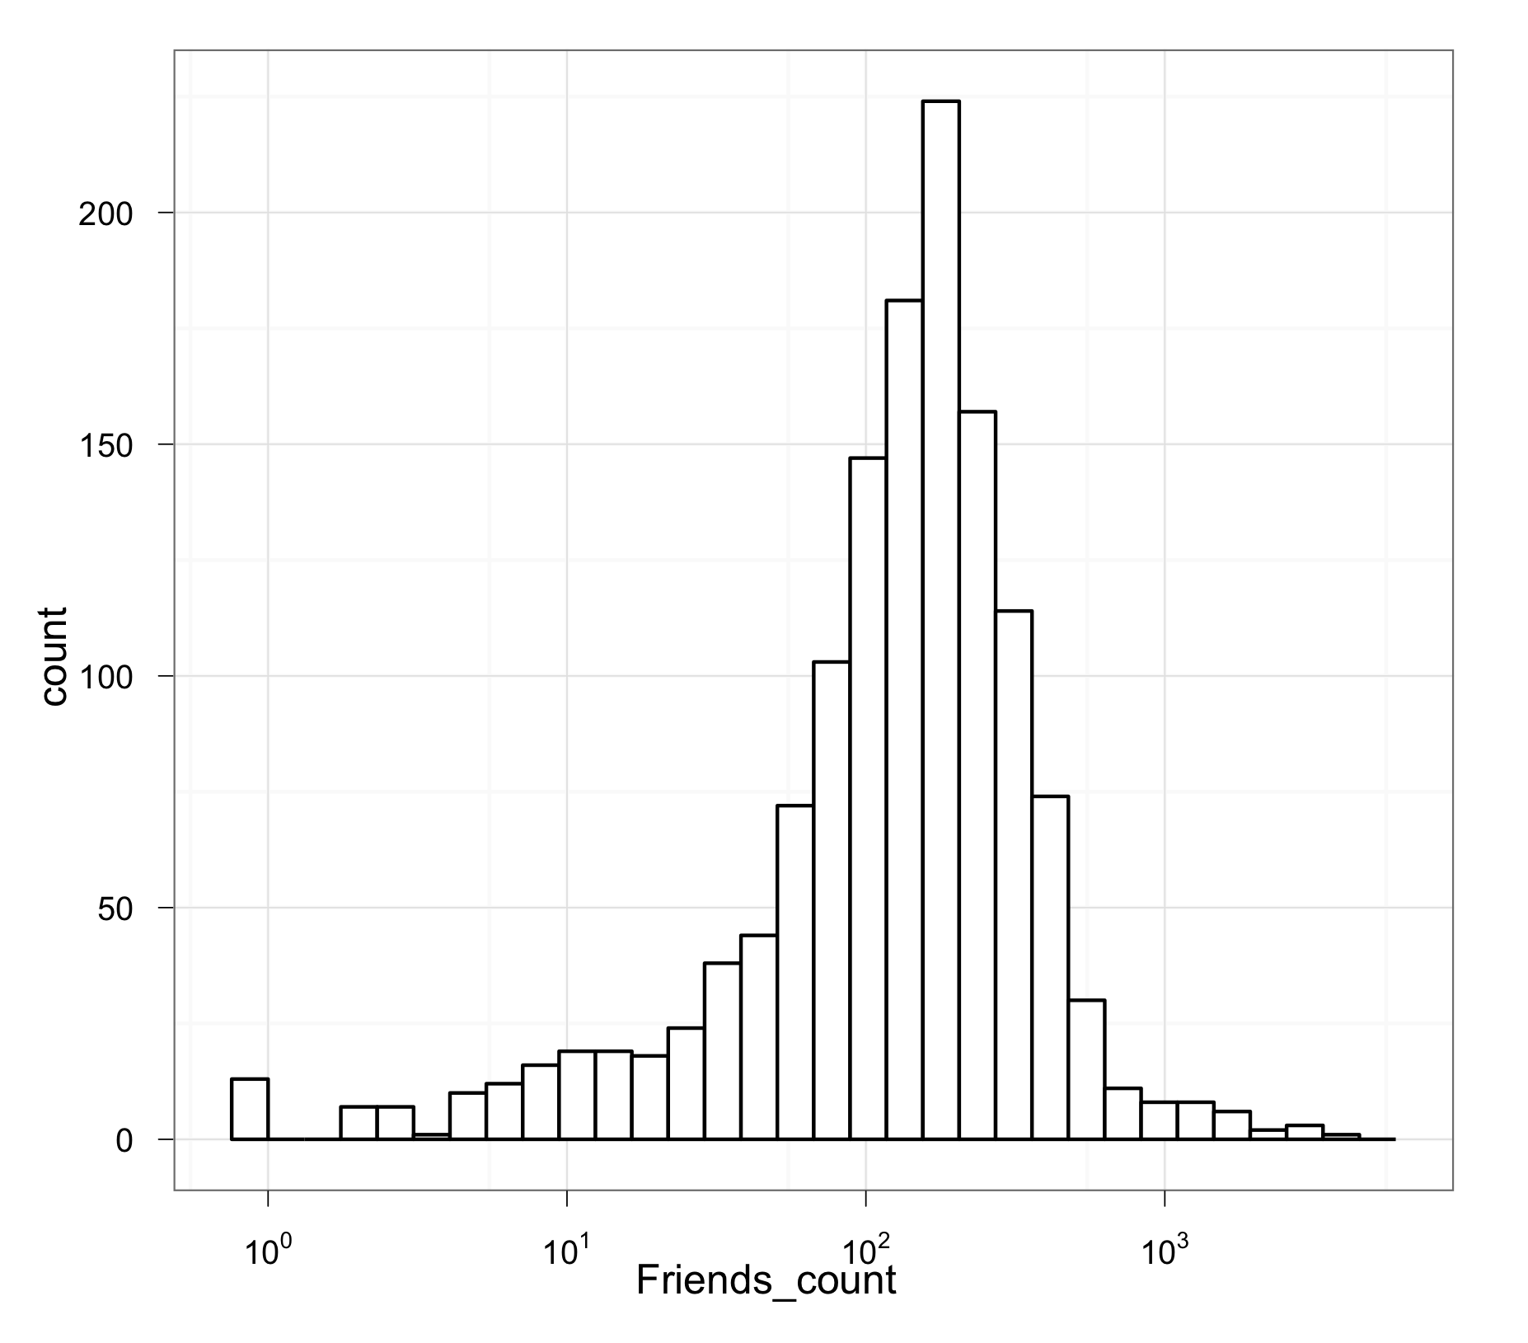
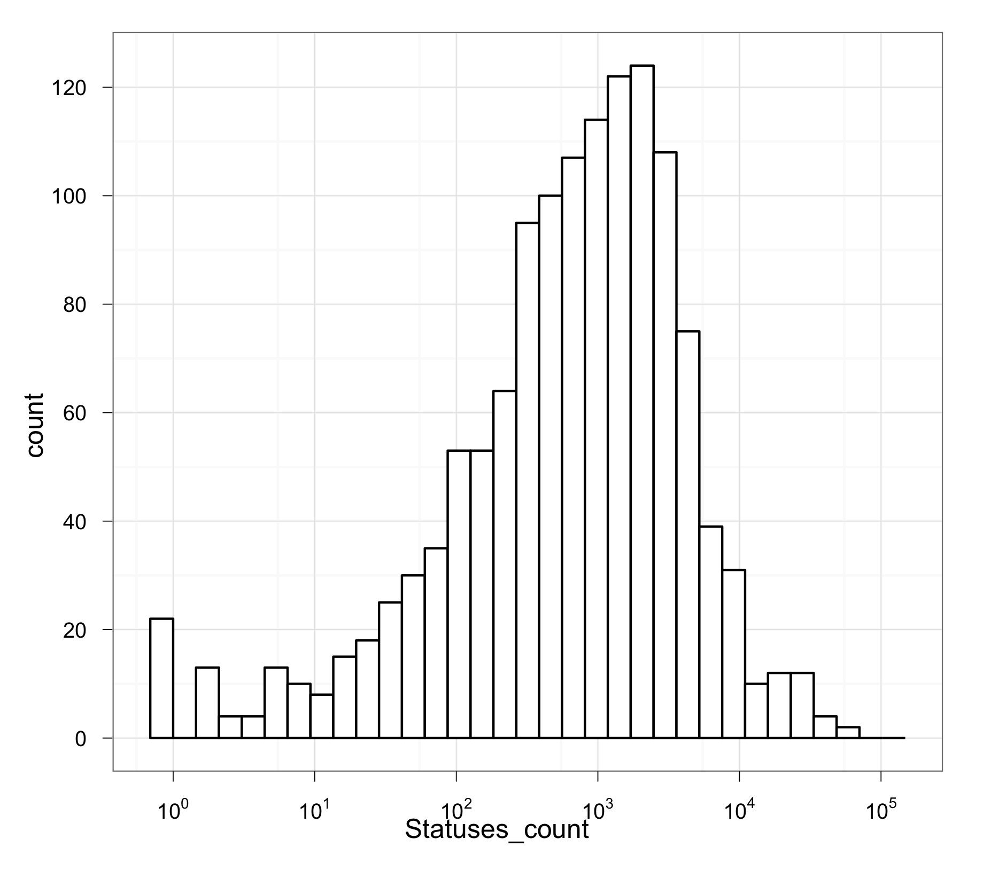
Typical Twitter Users
Median Followers: 118
Median Friends: 142.5
Median Tweets: 697.5

Slide 16
Our objective
Replicate Zamal & Ruths (2011) with unbiased sample of users
Features for predicting identity:
single words, bigrams, trigrams from users tweets
Hashtags from users tweets
URL domains from users tweets
Set of “friends” (people the user follows)

Slide 17
Most Distinctive Tokens
For each feature:
p(w|c) probability of token w given class c
w_{c} frequency of token w used by members of class c
Take 200 tokens with highest conditional probability

Slide 18
Supervised Learning
Seeds:
Create token lists for positive and negative class
Training:
Find parameters for feature lists that best predict identity for sample of users
Testing:
Measure how well parameters predict category for held-out sample of users

Slide 19

Salient Political Users
Replicating Zamal & Ruths with political figures
RYS,G: 0.82
P&P: 0.88
Z&R: 0.89

Slide 20
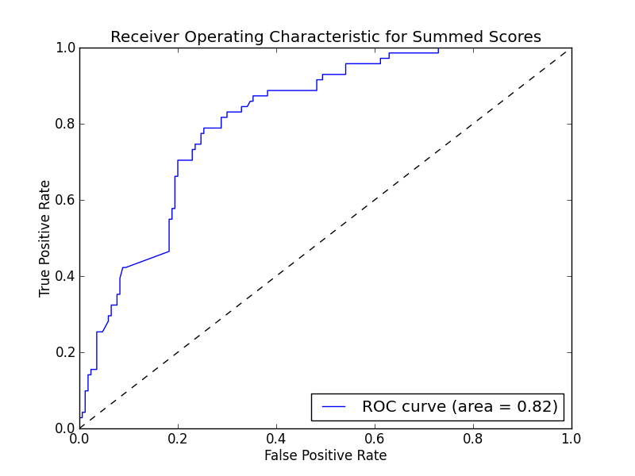
Typical Users: Gender

Slide 21
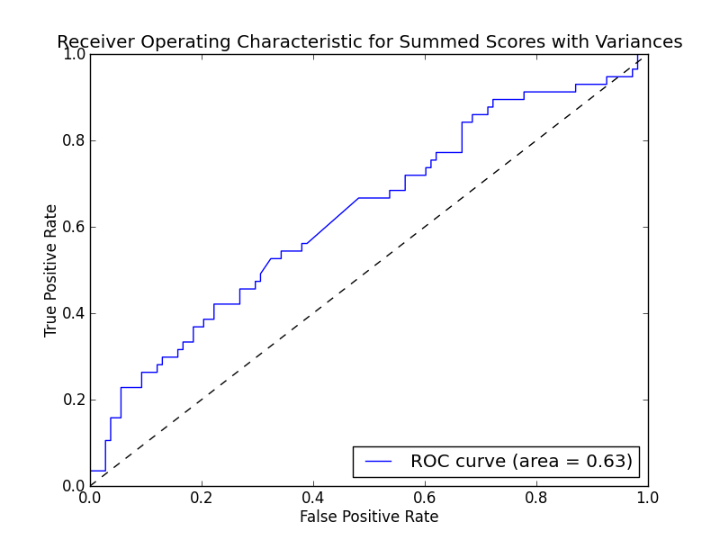
Typical Users: Political Identity Typical Seed Users (Accuracy .62)

Slide 22
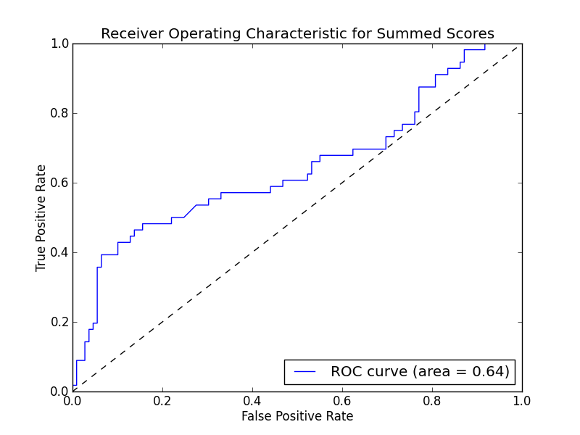
Typical Users: Political Identity Salient Seed Users

Slide 23
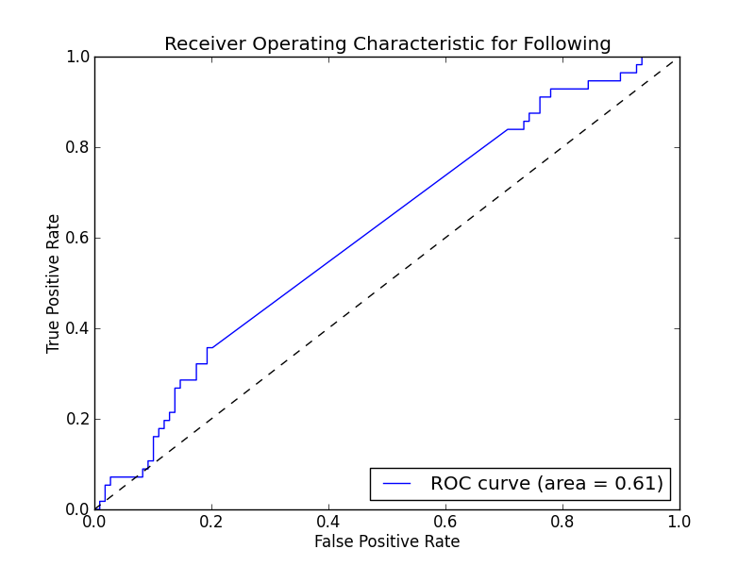
Best Individual Feature: Who People Follow (Accuracy .63)

Slide 24

Accuracy for typical users?

Slide 25
Most Distinctive Hashtags: Salient Political Users
#cutswecantafford, #healthcarereform, #bigoil, #jobcreation, #civilrights, #romneynotready
vs.
#obamagenda, #prolife, #stopthetaxhike, #cutspendingnow

Slide 26
Gender Hashtags
#tswift, #lolz, #sisters, #pwease, #happygirl, #haha, #rush, #sos, #lastnight, #prettyplease, #bestdayever, #thingsmydaddytaughtme, #boyfriend, #imissyou
vs.
#halo, #gameday, #colts, #collegegameday, #noshavenovember, #puckfurdue, #ravens, #salty, #thatisall, #storybehindmyscar

Slide 27
Most Distinctive Hashtags: Typical Users
#greatnight, #loser, #recruitment, #csflove, #roadtrip, #seriouslythough, #confused, #jesuspiece, #summer
vs.
#obama, #ff, #lmfao, #thewalkingdead, #again, #swerve, #win, #halo, #election, #thestruggle

Slide 28
Improving accuracy
Expanding the features that signal group identity:
Content of URLs tweeted
Deeper linguistic features
e.g., Only tweets with “we”, “us”, or “our”
Tweets with action verbs
Tweets of users followed by participants
More sophisticated models of tweets

Slide 29
α: Dirichlet prior
θ: topic distribution
η: prior on labels
Λ: distribution of labels
β: Dirichlet prior
φ: topic-word distribution
w: word
U: user
T: tweet
N: words in tweet
η
β
Λ
φ
U
T
N
α
θ
z_{T}
w
Notes:
Labeled tweet-topic model

Slide 30
Conclusion
Previous research has overestimated the ease with which one can infer latent group identity because of biased samples
There’s still work to be done to generalize!

Slide 31
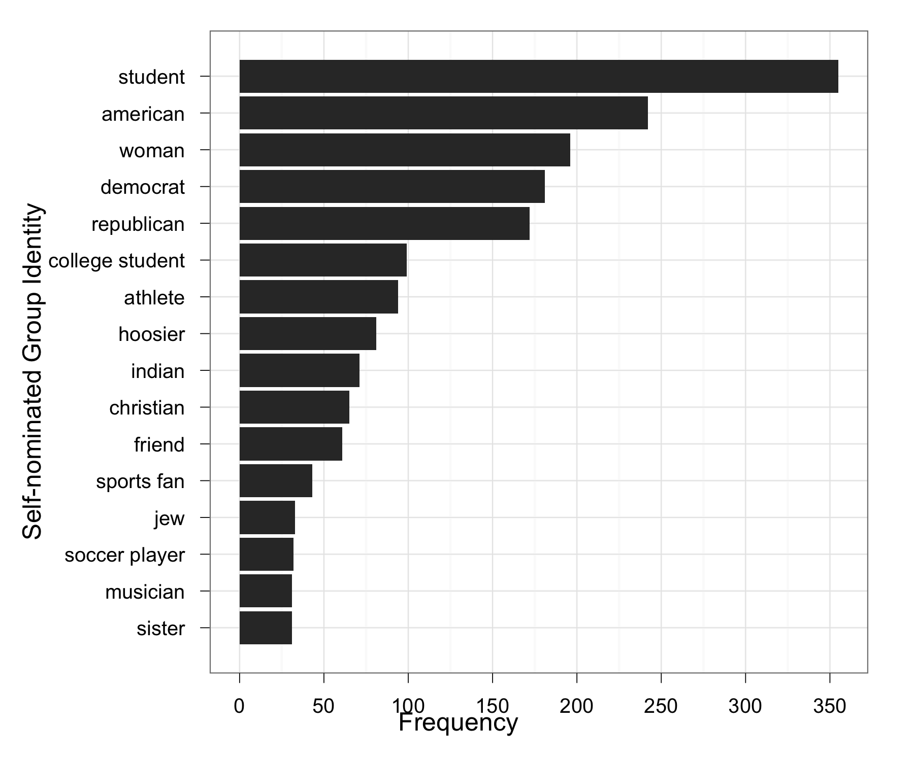
Next steps…
Improve accuracy of classifier for typical users
Test classifier on users’ self-nominated groups

Slide 32
Next steps…
Improve accuracy of classifier for typical users
Test classifier on users’ self-nominated groups
Predict strength of group identity
Predict information sharing given group identity
Experimentally measure difference in probability of sharing group-relevant vs. group-irrelevant information

Slide 33

Acknowledgements
Funding
Thomas Phillipeau
Thomas Imart
Kara Fasone

Slide 34


Slide 35

Many Parameters
Size of Seed, Training, and Testing Sets
Filters on the bigram and trigram measures.
Filters on the frequency of candidate distinctive terms
Filter for minimum users in the seed set using a term
Parameters in the Support Vector Machine algorithm

Slide 36
Pennacchiotti & Popescu 2011

